Slide 1
Trajectory Tracking Control of Robotic Manipulator using Deep Reinforcement Learning
EEN-400B B.Tech. Project
Anay Aggarwal (19115023), Anurag Srivastava (19117016), Sachin Agrawal (19115108)
Under the Supervision of Prof. Sohom Chakrabarty

Slide 2
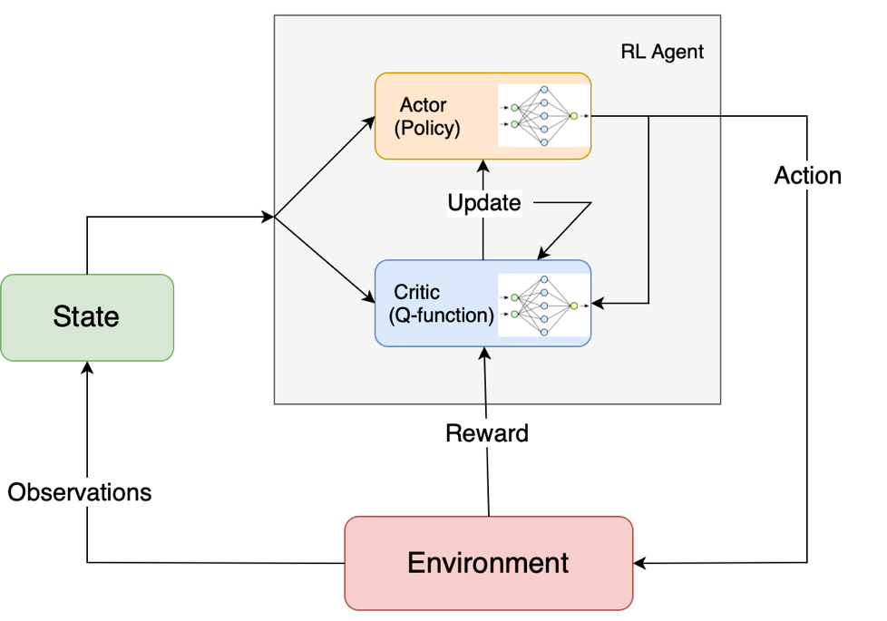
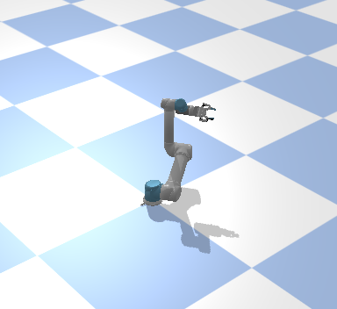
Introduction
Objective: Track a trajectory using the robotic arm
Used DDPG algorithm
Initially, worked on 2D model
After success, moved to 3D model
Rigorously trained the 3D model
3D Simulation
Overview of DDPG Algorithm

Slide 3
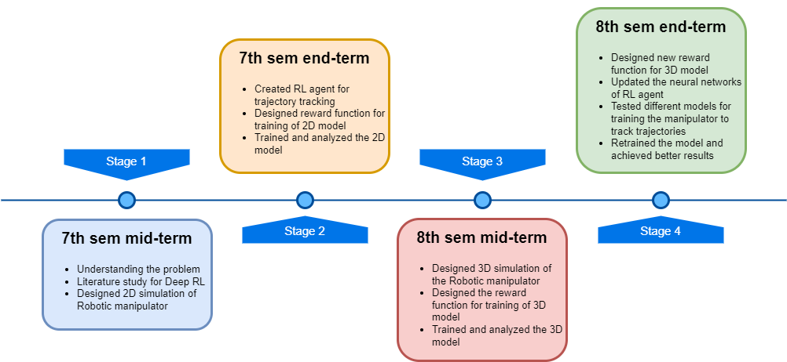
Timeline

Slide 4
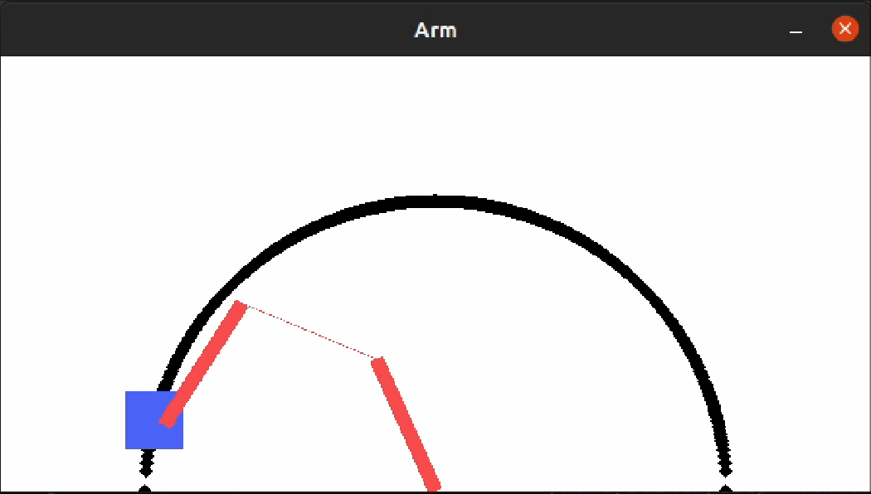
2D Model
Simulated and tested a 2D version of the robotic manipulator using pyglet.
Created action and state spaces and the reward function.
Achieved impressive accuracy.
Helped transition to the current 3D model.

Slide 5
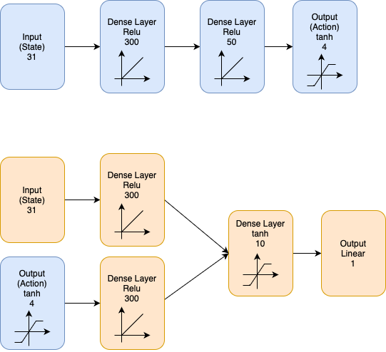
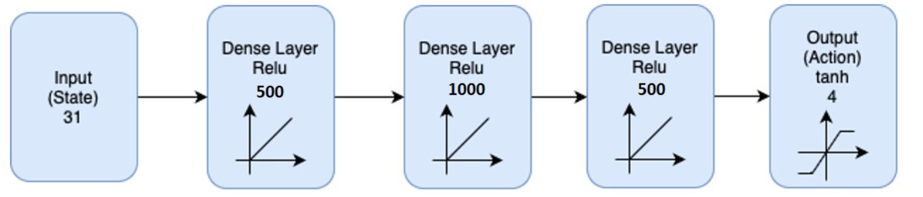
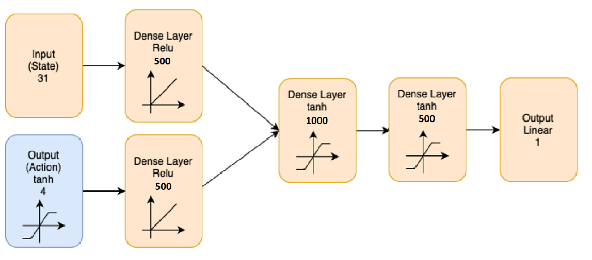
Actor and Critic Network
2 neural networks – ‘Actor’ and ‘Critic’.
Actor gives out the action
Critic gives out the Q-Value
Old Actor network
Updated Actor network
Old Critic network
Updated Critic network
Notes:
Since our model is going to track trajectories, we will have continuous action and state spaces, so ddpg helps us because it supports stochastic action and state space. We have 2 neural networks called actor and critic. Actor is reward based while critic is value based. Actor network takes the state and decides the next action. The critic network takes the action and state, uses the reward obtained to calculate a q-value, predicts a new q-value and calculates the TD error. Then, the action is performed. RL agent then updates both the networks using the td error and reward. In the Actor network, the input layer consists of 31 values which are states of the robotic manipulator. The 1st layer has 300 neurons and uses relu activation function, 2nd layer has 50 And uses relu activation function and the 3rd has 4 neurons in actor (action) with tanh activation function. In the critic network, the input has 31 state values and 4 action values. The 1st layer has 300 neurons with Relu activation, 2nd layer has 10 neurons with tanh activation function and 3rd layer is the output layer which gives the q-value. Relu is used to get a value between 0 and 1, while tanh gives the value between -1 and +1.

Slide 6
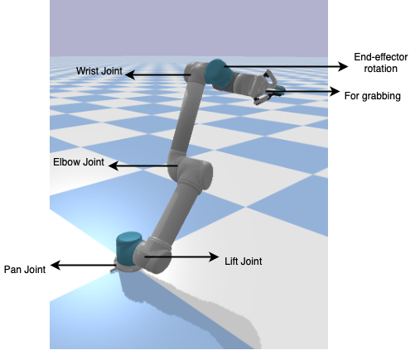
Action and State
The action is an array of 4 floating-point numbers which represent the angles by which each of bottom 4 joints must move in clockwise direction.
The state is an array of 31 floating-point number which represent the coordinates of joints and the distance between points on the robot and goal.
Action: [a_{p}, a_{l}, a_{e}, a_{w}]
State: [p_{x} , p_{y} , p_{z} , (p_{x}-g_{x}) , (p_{y}-g_{y}) , (p_{z}-g_{z}) , ….. ]
Where, p_{x} , p_{y} , p_{z} are x, y, z coordinates of pan joint
g_{x} , g_{y} , g_{z} are x, y, z coordinates of goal point
State consists of values for other bottom joints (pan joint, lift joint, elbow joint, wrist joint, end-effector) giving 30 values and the 31st value determining whether end-effector reached the goal or not.

Slide 7
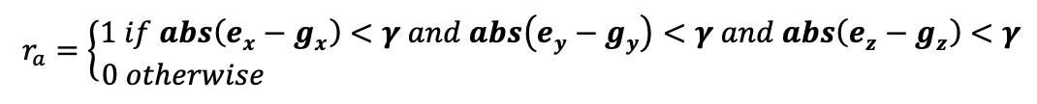
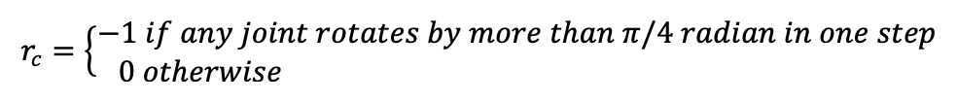
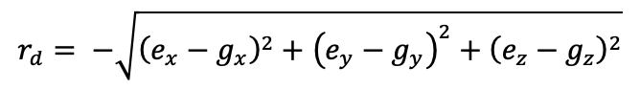
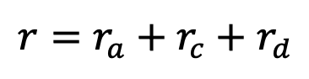
Old Reward Function
Arrive Reward
Constraint Reward
Distance Reward
Overall Reward
Notes:
As we know, very crucial part of the RL model if the reward. So this is the reward function which is the summation of 3 rewards.
Arrive reward: end point within 20 pixels of the goal point then 1 else 0
Constraint reward: This handles the reward if any point on the arm goes below base line. -1 is x<0 else 0
Distance reward: negative of the distance of the end point of arm from goal. Thus if distance reduces then reward increases.
Thus overall reward is used to train the RL model

Slide 8
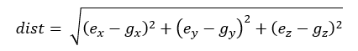
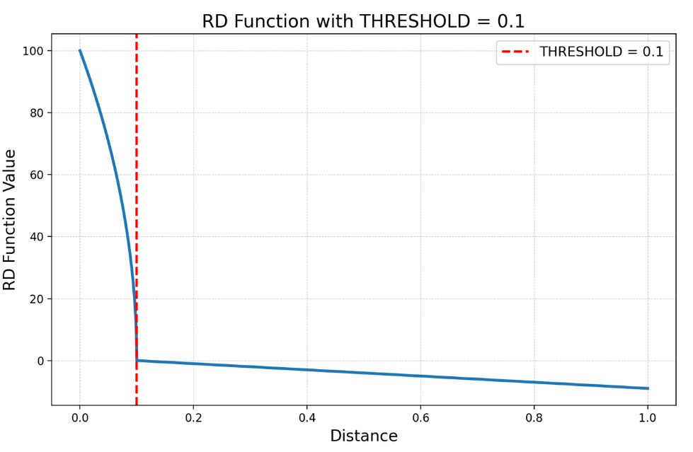
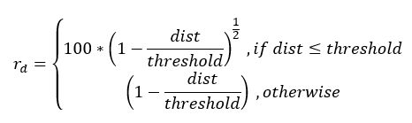
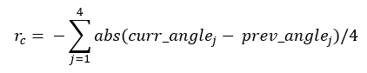
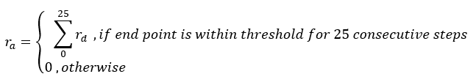
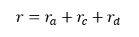
New Reward Function

Slide 9
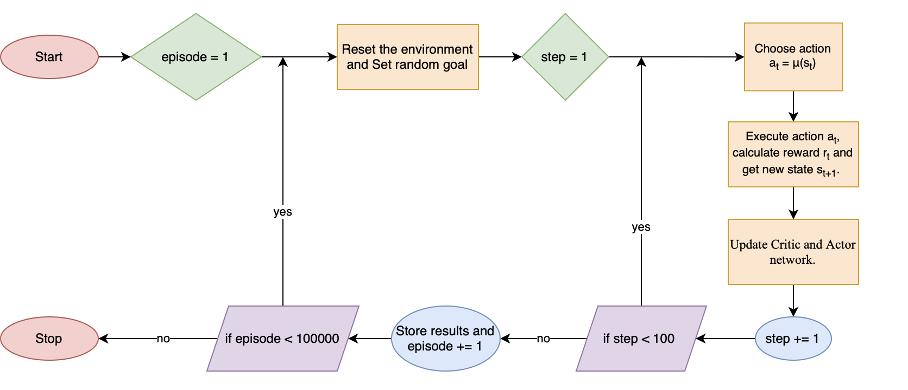
Training Algorithm
Flowchart of Training Algorithm

Slide 10
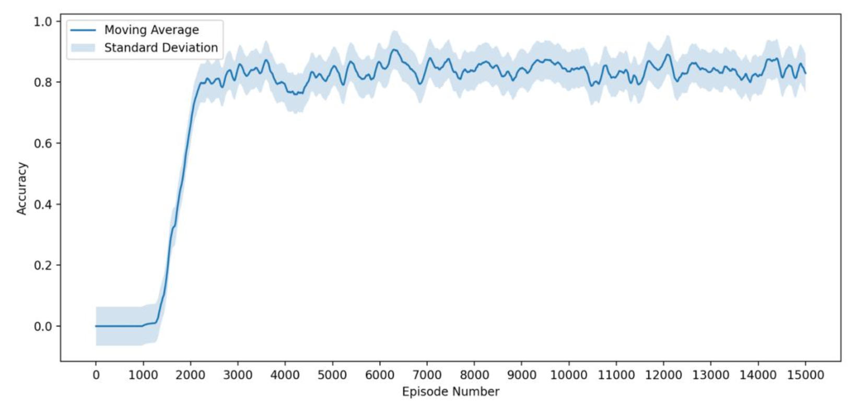
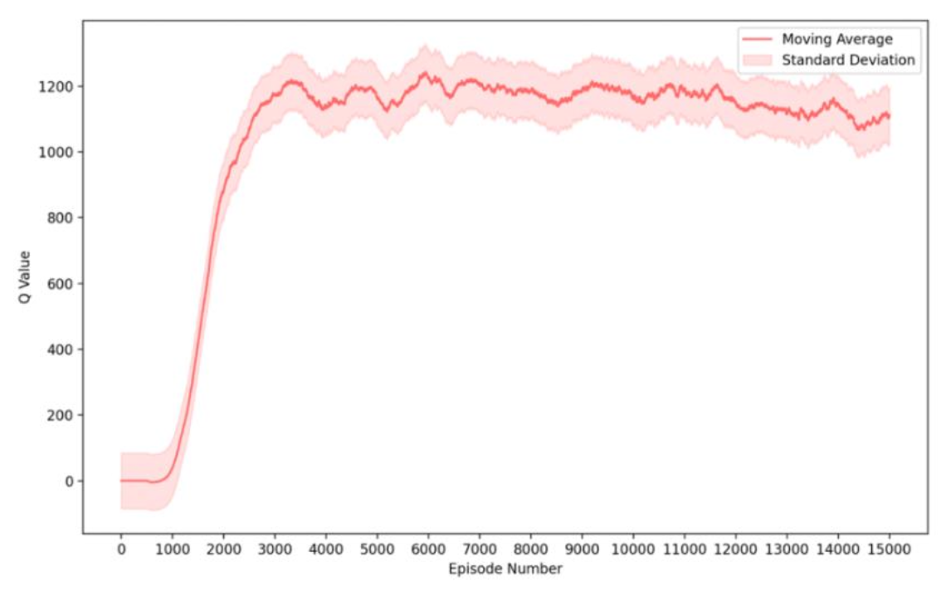
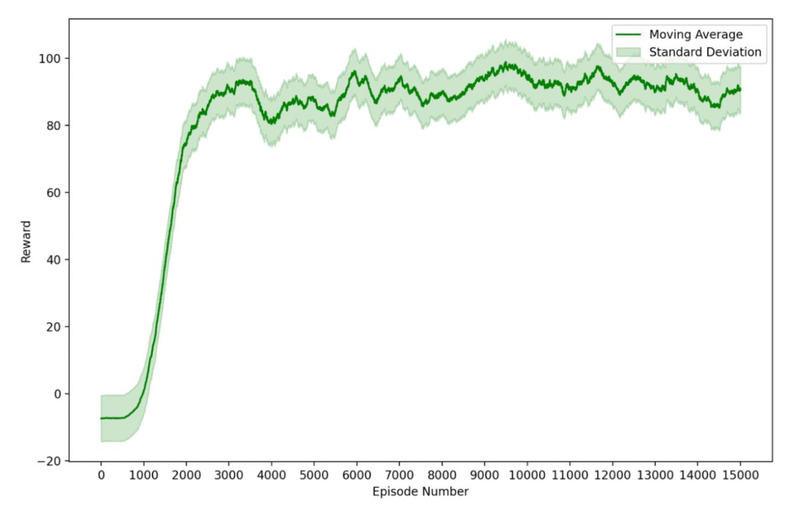
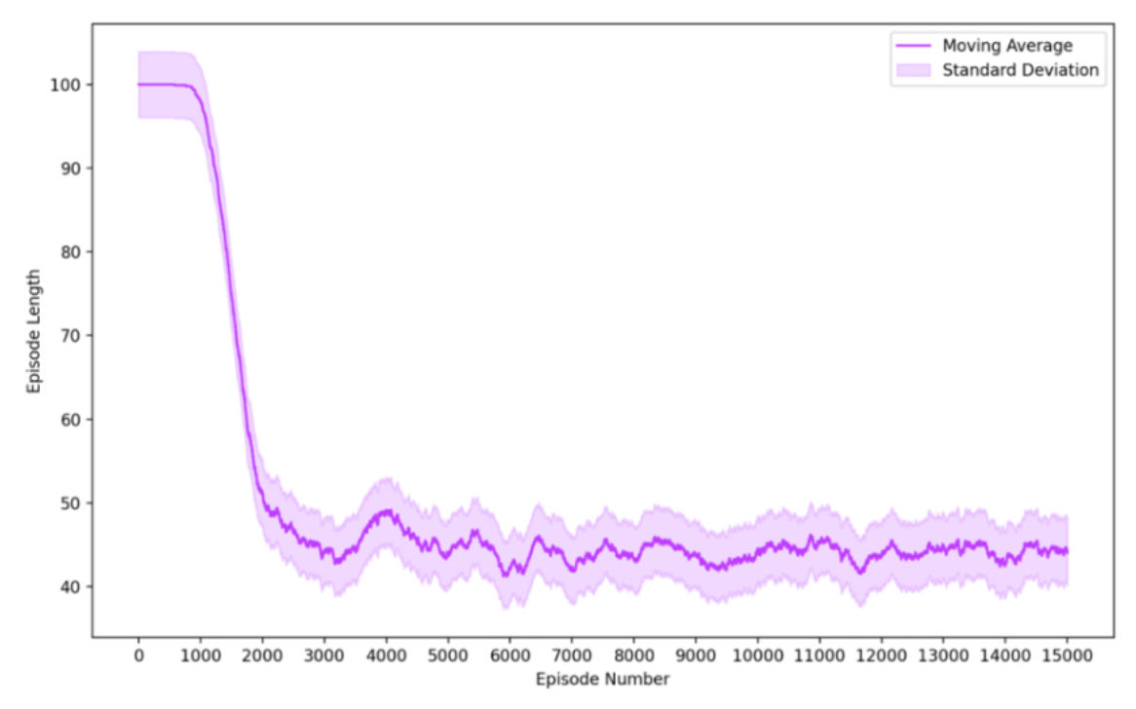
Training Results
Plot of Accuracy vs episode
Plot of Q Value vs episode
Plot of Reward vs episode
Plot of Episode Length vs episode
Notes:
These are the plots of accuracy and reward vs no of episodes. This is the training accuracy. We trained it for 5000 episodes and there were 200 steps per episode.
It can be observed that the accuracy is 0 till 300 episodes are completed, this is the exploration phase of training. During this time, the agent takes random actions to get a sense of the environment. Once the agent starts learning from its action the accuracy rapidly improves and reaches saturation.
Similarly, the reward is highly negative during the start of training as the model is taking random actions due to which it is nowhere near the goal point. As the model learns it can reach goal point in fewer number of steps per episode and the rewards are positive.

Slide 11
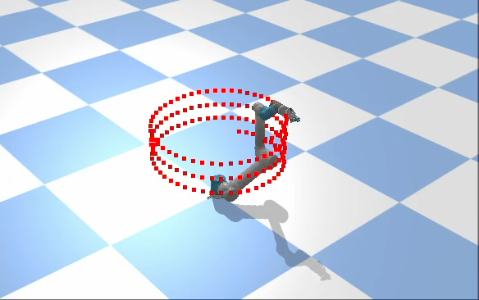
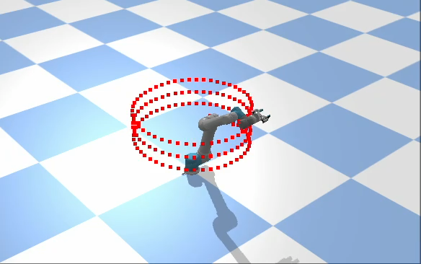
Tracking of helical trajectory
Old Model
New Model
Notes:
Here, we are tracking a rectangular trajectory. In each episode the arm tries to reach a point, and if it fails to do so in 20 steps (actions) then we move on to the next point. As the arm takes several small actions to reach a point, it is ensured that the movement of the arm is smooth, i.e., the arm do not make large movements in small time. 99.51%

Slide 12
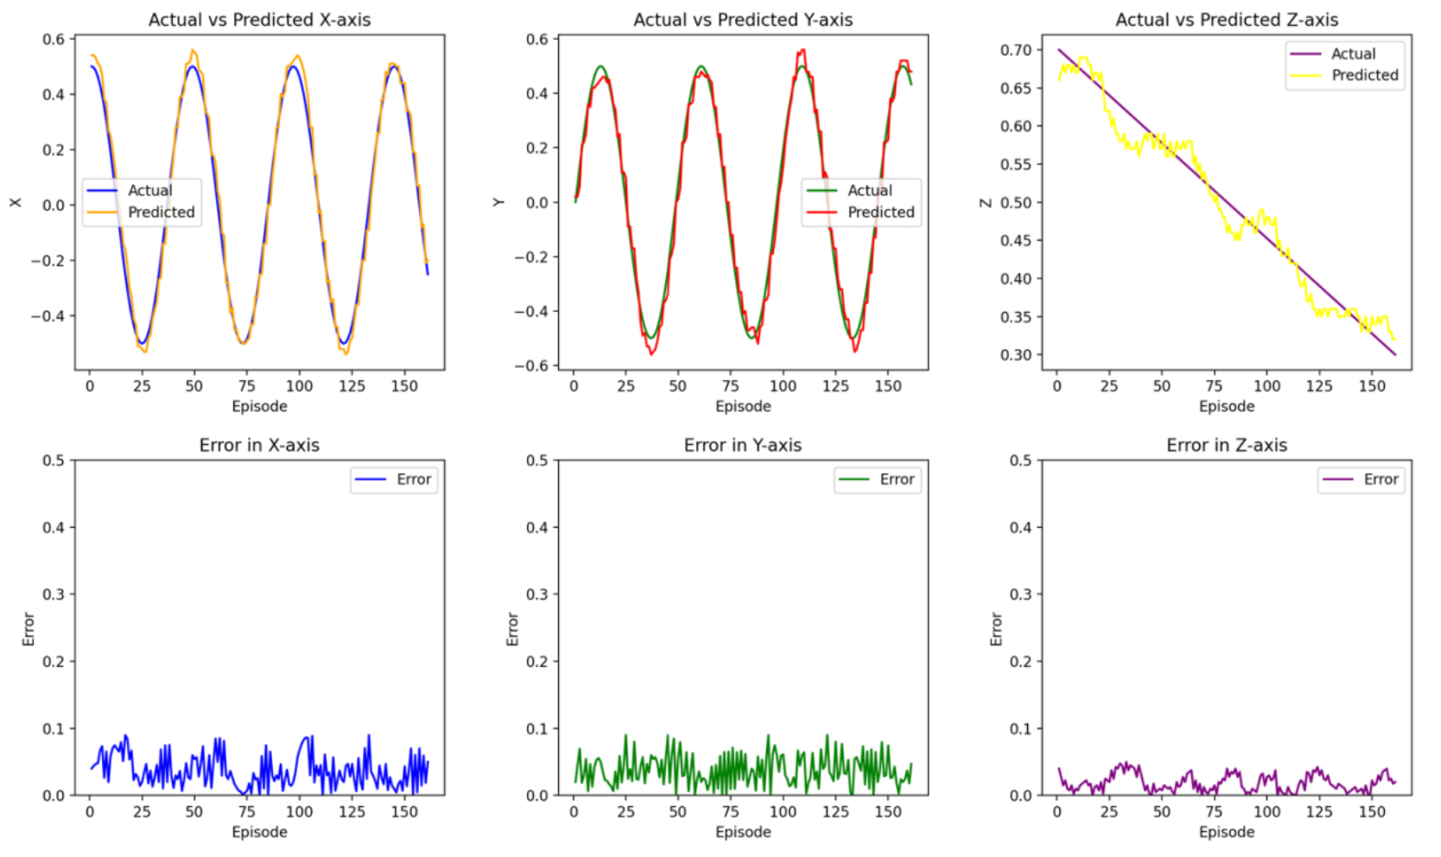
Analysis of trajectory tracking of helix

Slide 13
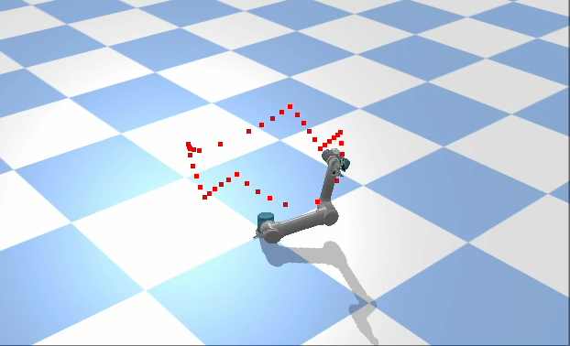
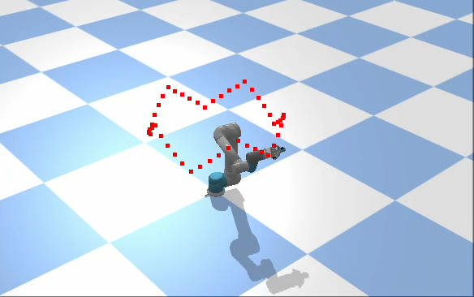
Tracking of crown-shaped trajectory
Old Model
New Model
Notes:
In this animation we are testing our trained model to track a semicircle trajectory. The trajectory is converted to a series of points. The arm tries to reach one point per episode. Before each step, state space is generated and sent to the RL agent which decides the action to take. 99.39%

Slide 14
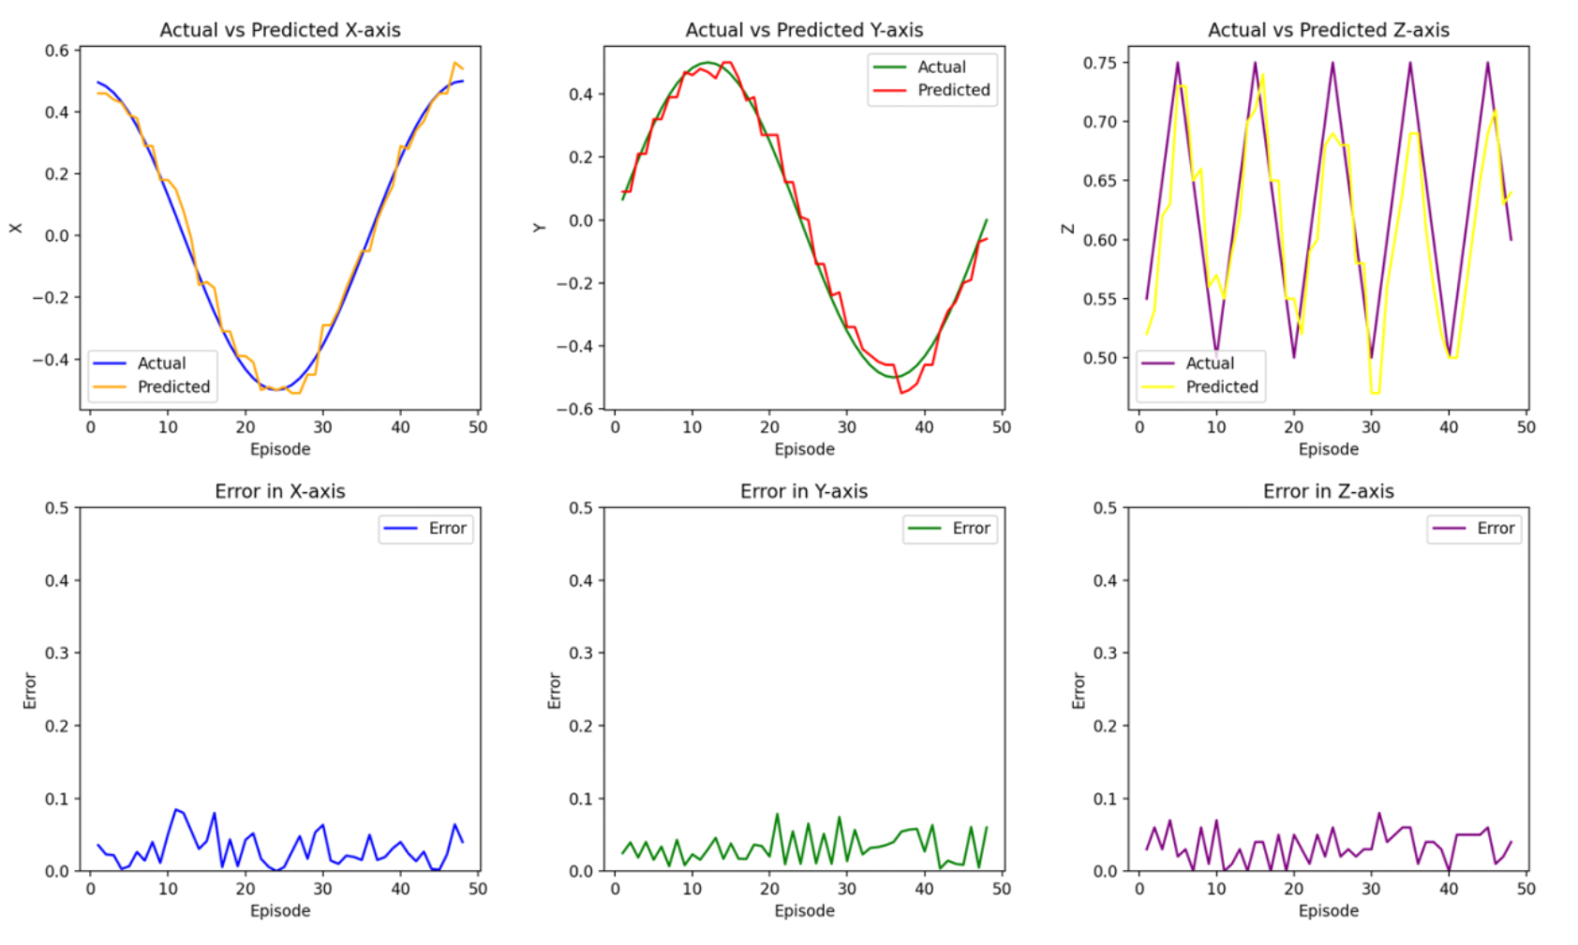
Analysis of trajectory tracking of crown

Slide 15
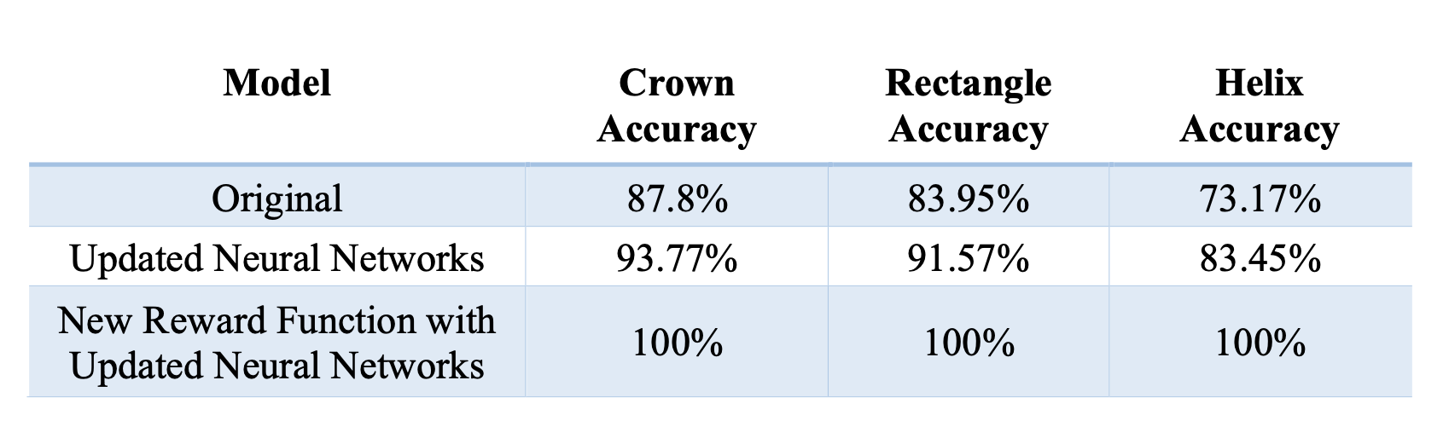
Results of testing
Accuracy of trajectory tracking using different models

Slide 16
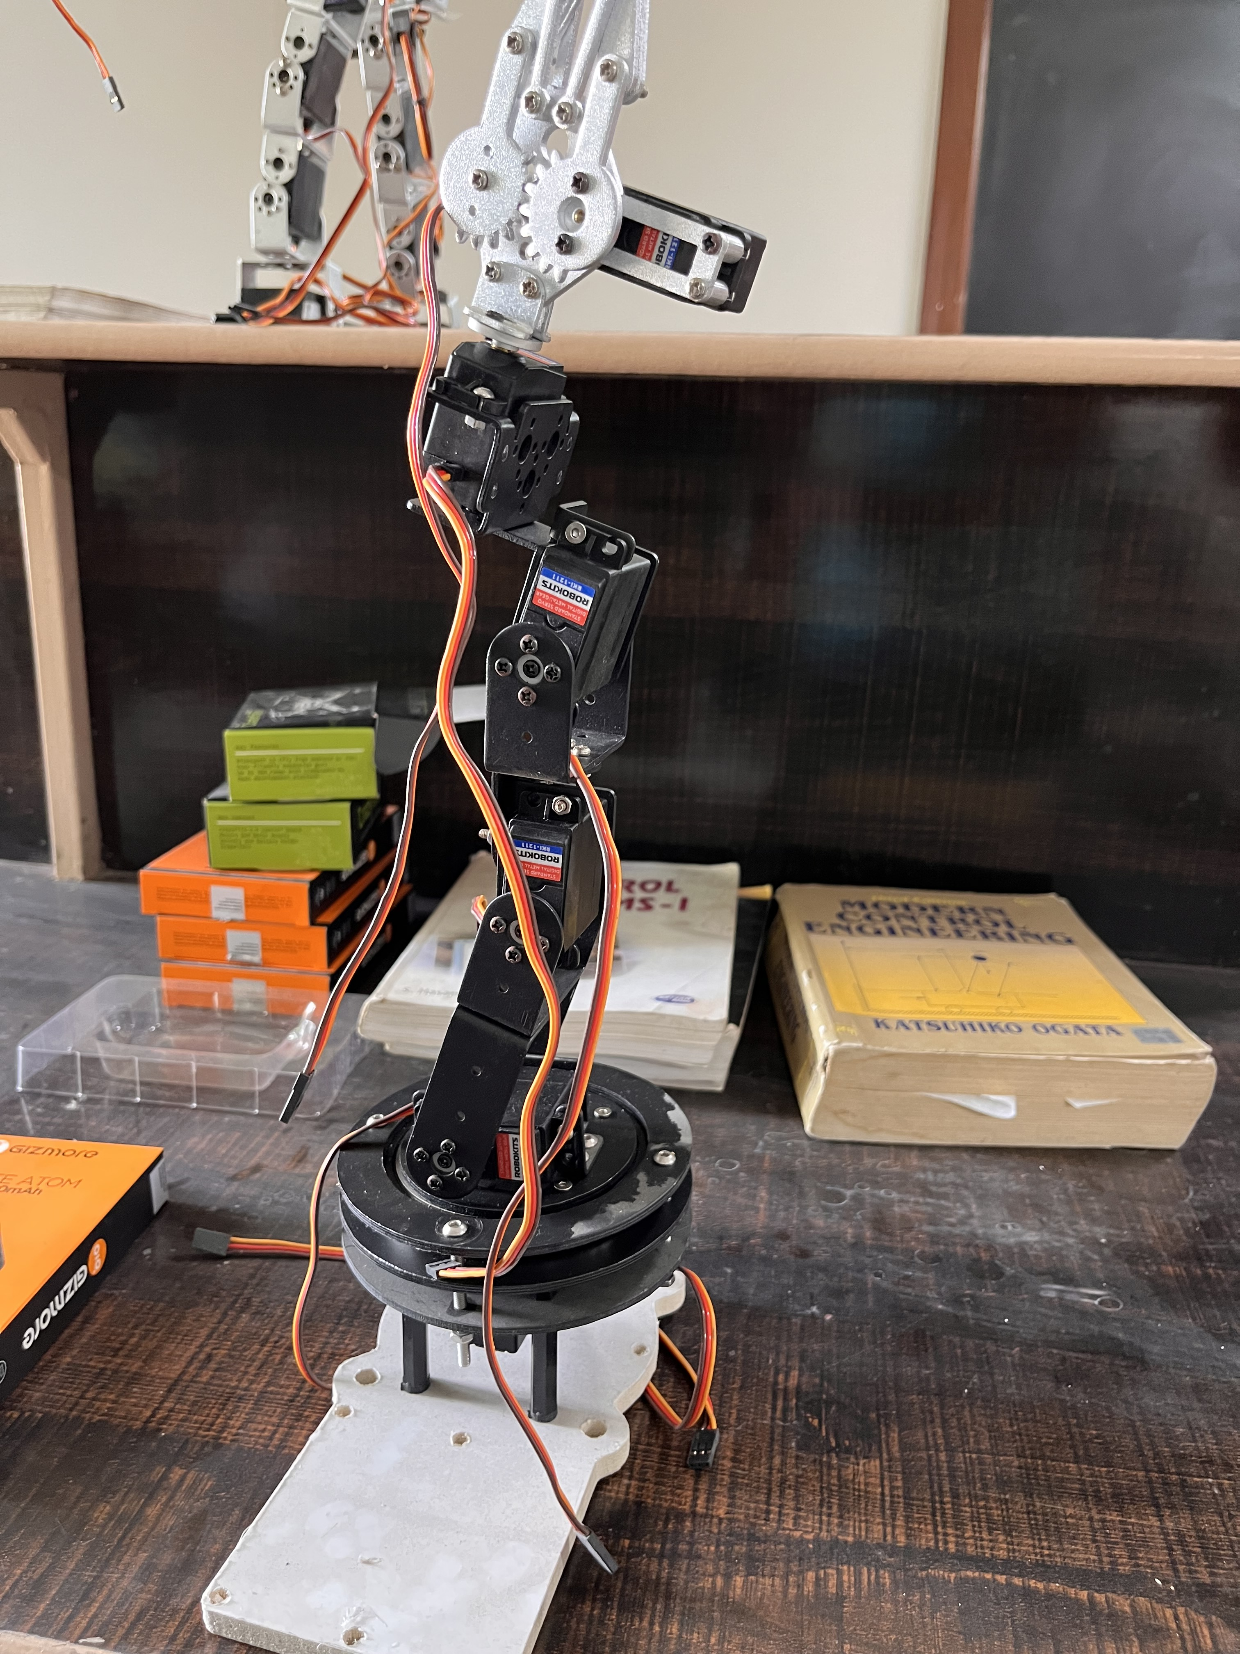
Further Work
Addition of noise
Hardware implementation
Training for other tasks such as grasping,
object manipulation, etc.
Simulation
Hardware
Notes:
Till now, we have successfully simulated a 2d model to run on a given trajectory. Next we will expand the action and state space so that it can support 3 dimensional trajectories. Finally, we will deploy this agent on actual hardware and test several trajectories using it. We can also implement pick and place operations on the hardware.

Slide 17
References
Wenxing Liu, Hanlin Niu, Muhammad Nasiruddin Mahyuddin, Guido Herrmann and Joaquin Carrasco; A Model-free Deep Reinforcement Learning Approach for Robotic Manipulators Path Planning; 2021 21st International Conference on Control, Automation and Systems (ICCAS); 2021
Kai Arulkumaran, Marc Peter Deisenroth, Miles Brundage, Anil Anthony Bharath , “A Brief Survey of Deep Reinforcement Learning” in IEEE SIGNAL PROCESSING MAGAZINE, SPECIAL ISSUE ON DEEP LEARNING FOR IMAGE UNDERSTANDING, rXiv:1708.05866v2 [cs.LG] 28 Sep 2017
Kim J, Kim SR, Kim SJ and Kim DH. A practical approach for minimum- time trajectory planning for industrial robots. Industrial Robot: An International Journal, vol. 37, pp. 51–61, 2010.
Thank you

